Slide 1
Mining Trends in the FDA Adverse Events Reporting System
Jay Kwon

Slide 2
Background
Pharmacovigilance
The practice of monitoring the effects of medical drugs after they have been licensed for use, especially in order to identify and evaluate previously unreported adverse reactions.
Importance
Regulatory intelligence for government and big pharma
Information for affected patients
Research
As diseases become more and more complex, so too do their treatments, and the regulations for those treatments.
Drugs, biologics, ADCs, etc.

Slide 3

Limitations
Regulatory intelligence not readily accessible.
Lots of background noise to sift through
Volume, computing power, speed
Natural language processing

Slide 4
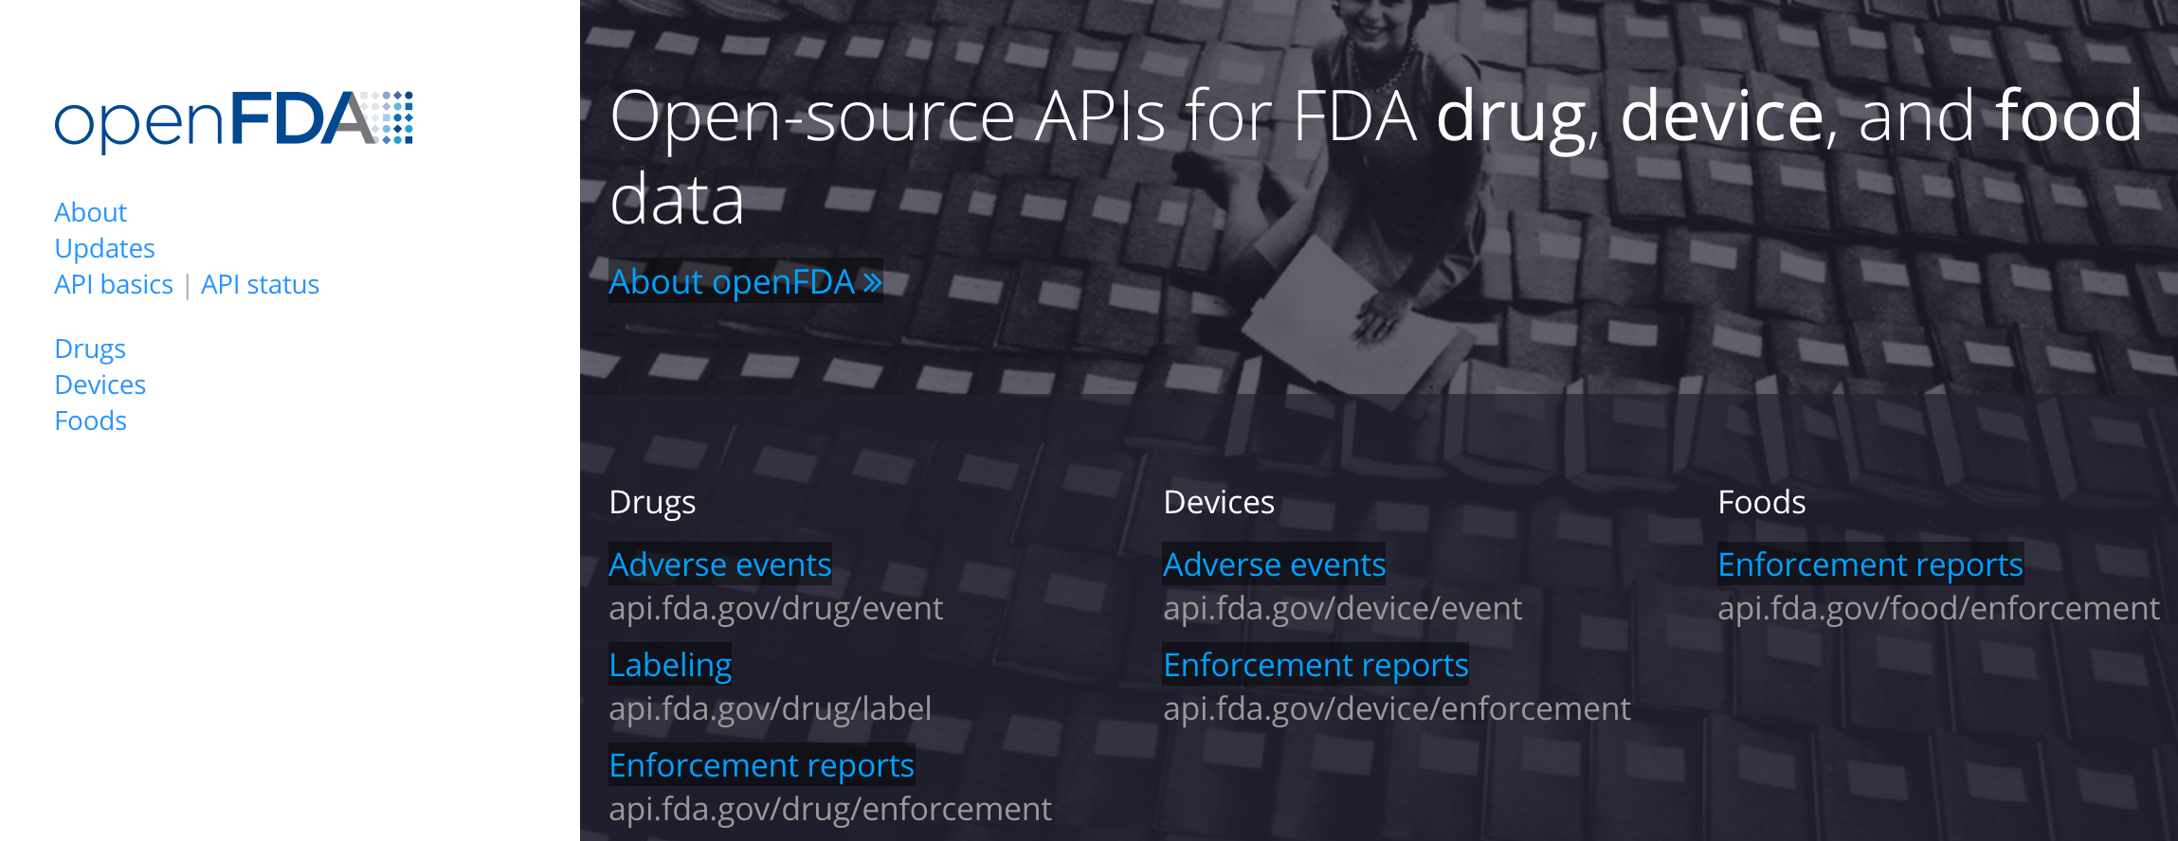
FDA Data
Open FDA

Slide 5
FDA Data
FAERS/LAERS
FDA Adverse Event Reporting System
Legacy Adverse Event Reporting System
Quarterly reports of adverse events since 2004
Not as nicely formatted as data from open FDA (JSON)
Ascii/xml
Total of 46 separate datasets with 7 different tables:
Demographics, Drug, Reaction, Outcome, Therapy, Report Source, Indication
Anywhere from 2 to 25 columns

Slide 6
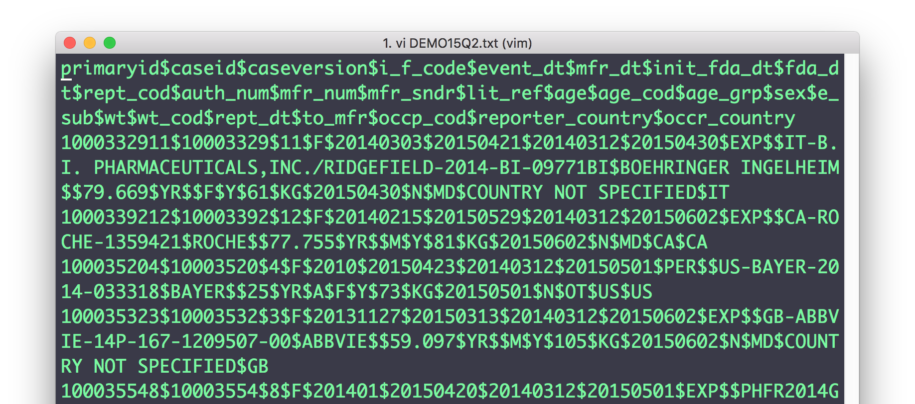
Demographics
Logs every unique adverse event case reported
25 columns, including date, gender, age, reporter country etc.
About 6.8 million individual reports

Slide 7
Demographics: Country

Slide 8
Demographics: Country

Slide 9
Demographics: Reports

Slide 10
Demographics: Reports

Slide 11
Demographics: Age

Slide 12
Demographics: Gender

Slide 13
Demographics: Gender

Slide 14
Demographics: Follow-up

Slide 15
Demographics: Follow-up

Slide 16
Demographics: Reporter

Slide 17
Demographics: Reporter

Slide 18
Demographics: Reporter

Slide 19
Demographics

Slide 20
Demographics

Slide 21
Demographics

Slide 22
Demographics

Slide 23
Patient Outcomes
Primary table that categorizes what happened to the patient as a result of the adverse event
Joining other tables with the demographic information can get interesting

Slide 24
Patient Outcomes

Slide 25
Patient Outcomes: Death

Slide 26
Patient Outcomes: Death

Slide 27
Patient Outcomes: Hospitalization

Slide 28
Patient Outcomes: Hospitalization

Slide 29
Death and Patient Age

Slide 30
Death and Patient Weight

Slide 31
Death and Gender

Slide 32
Death and Followup

Slide 33
Drug Information
By far the messiest database of everything in FAERS/LAERS.
Contains information on the drug related to the adverse event
Dosage, level of suspicion, potential interaction with other drugs, etc.
Unfortunately…
Was unable to process these tables in a timely manner
Partial selection of less than half of available data (due to many errors being unfixable without iterating over entire files), still over 14 million entries
Some findings in conclusion

Slide 34
Conclusions
Lots of interesting analysis can be done with the provided data
Caveat: case-only, no control
Given that an adverse event occurred in response to administering a drug, the general association is that the following are correlated with death:
Age
Weight
Gender
Followup
Some findings from the partial data (still, some 14m rows) obtained from drug information tables:
Most reports filed for Humira (rheumatoid arthritis)
Most primary suspect drug in adverse event also Humira
Top drugs causing adverse events related to rheumatoid arthritis

Slide 35
Moving Forward
All code and partial data available on GitHub
Find a better way to process Drug information to remove broken lines
Perform further analysis on what drugs are the most significantly correlated with patient death, given an adverse drug event

